Slide 1

vSphere

Slide 2

vSphere Overview
What is Virtualization
Types of Virtualization
What is a Hypervisor
Types of Hypervisor
What is VMware vSphere Client
How to install vSphere Client
Important features of vSphere Client

Slide 3
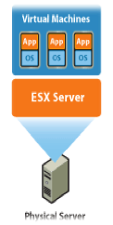
Virtualization
It is the technique of splitting a physical Resource into as many Logical resource as we want. Example. CPU, Memory
OR
Virtualization is a technology that transform hardware into Software
Mainly Virtualization means, running multiple operating systems on a single machine but sharing all the hardware resources.

Slide 4
Types of Virtualization
Hardware Virtualization
In hardware virtualization, the virtual machine manager i.e. VMM is located and installed on the hardware system.
The main use of hypervisor over here is to monitor and control the memory, processor and other resources of hardware.
Operating System Virtualization
Operating system virtualizations uses the software which allows system hardware to run multiple operating systems concurrently. Most of the companies use OS Virtualization because it is economical, reliable, and flexible.
Storage Virtualization
Storage virtualization is the process of grouping the physical storage from multiple network storage devices so that it looks like a single storage device.
Storage virtualization is also implemented by using software applications.

Slide 5
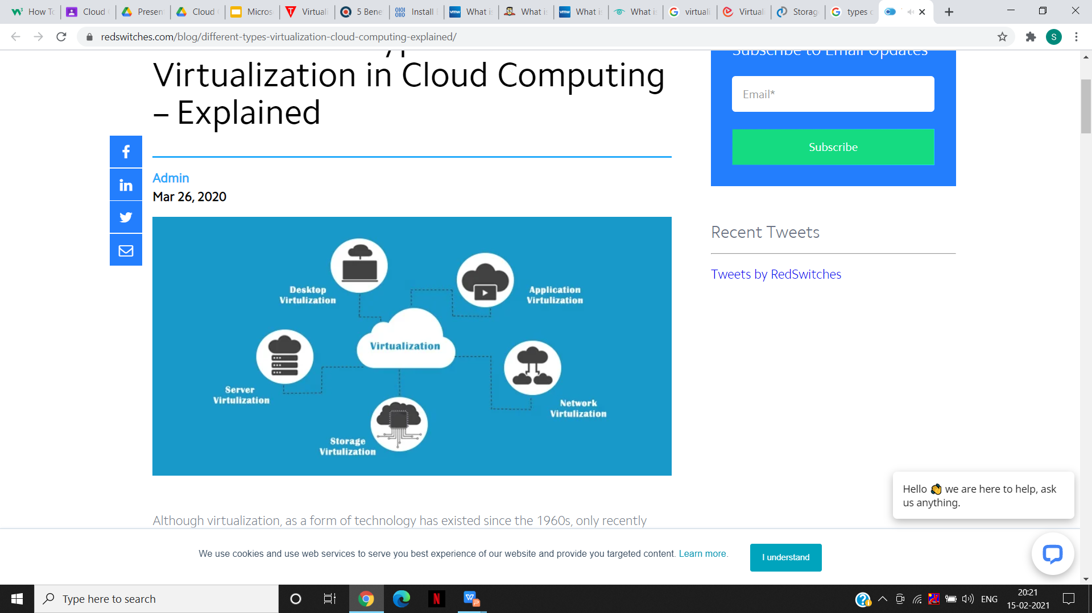
Server Virtualization
When the virtual machine software or virtual machine manager (VMM) is directly installed on the Server system is known as server virtualization.
Server virtualization is done because a single physical server can be divided into multiple servers on the demand basis and for balancing the load.

Slide 6
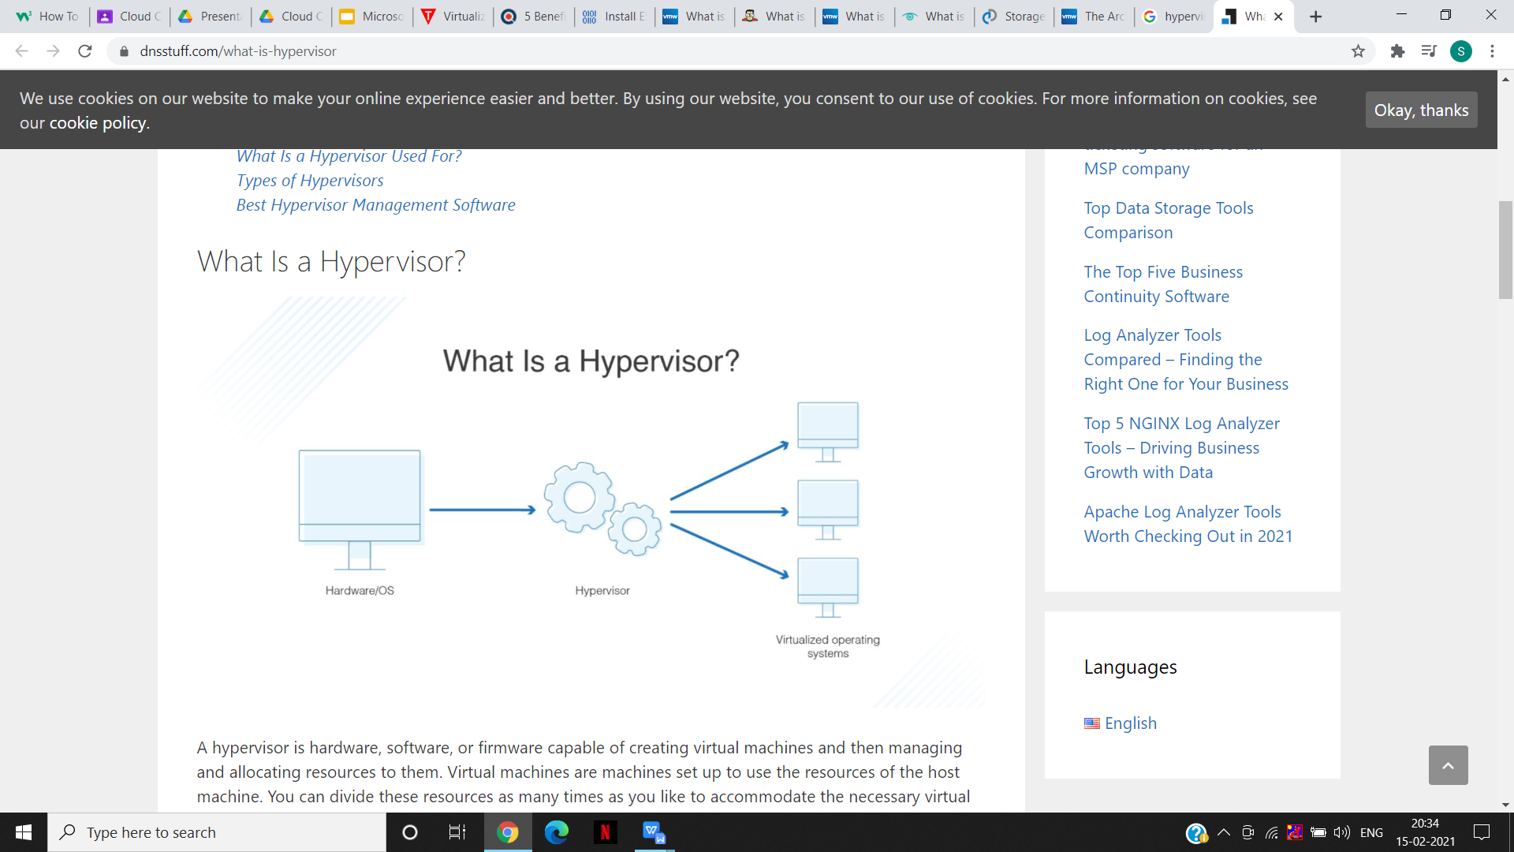
What is a Hypervisor
A hypervisor, also known as a virtual machine monitor or VMM, is software that creates and runs virtual machines (VMs). A hypervisor allows one host computer to support multiple guest VMs by virtually sharing its resources, such as memory and processing.
There are two main hypervisor types, referred to as Type 1 and Type 2. A type 1 hypervisor acts like a lightweight operating system and runs directly on the host’s hardware, while a type 2 hypervisor runs as a software layer on an operating system, like other computer programs.

Slide 7
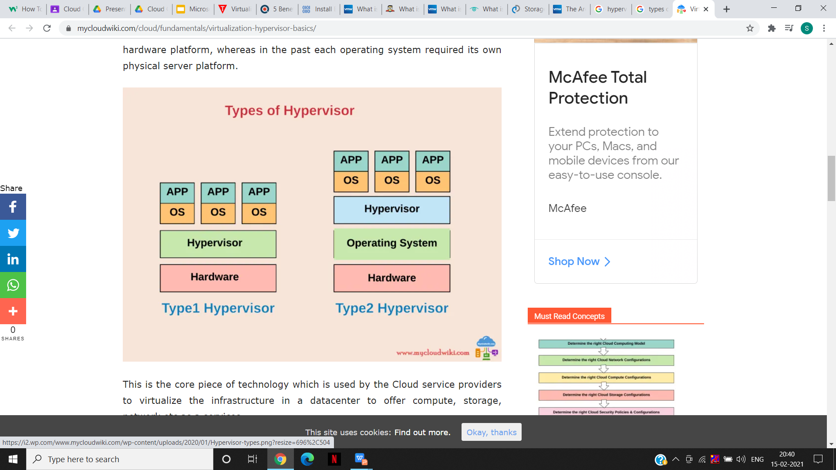

Slide 8
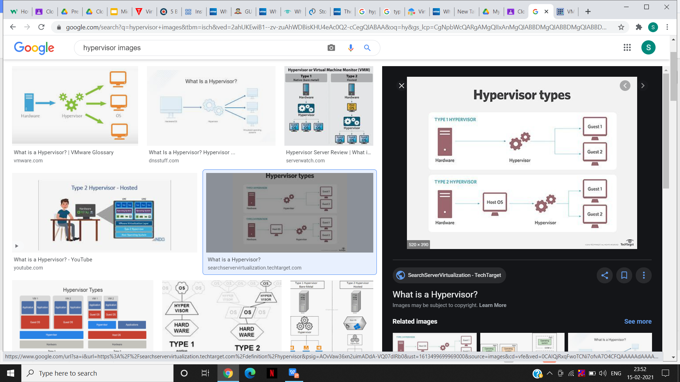
Type 1 hypervisors – also called bare metal hypervisors, Type 1 hypervisors run directly on the system hardware. A guest operating-system runs on another level above the hypervisor. VMware ESXi is a Type 1 hypervisor that runs on the host server hardware without an underlying operating system.
Type 2 hypervisors – hypervisors that run within a conventional operating-system environment, and the host operating system provides I/O device support and memory management. Examples of Type 2 hypervisors are VMware Workstation and Oracle VirtualBox .
The core of the vSphere product suite is the hypervisor called ESXi.

Slide 9
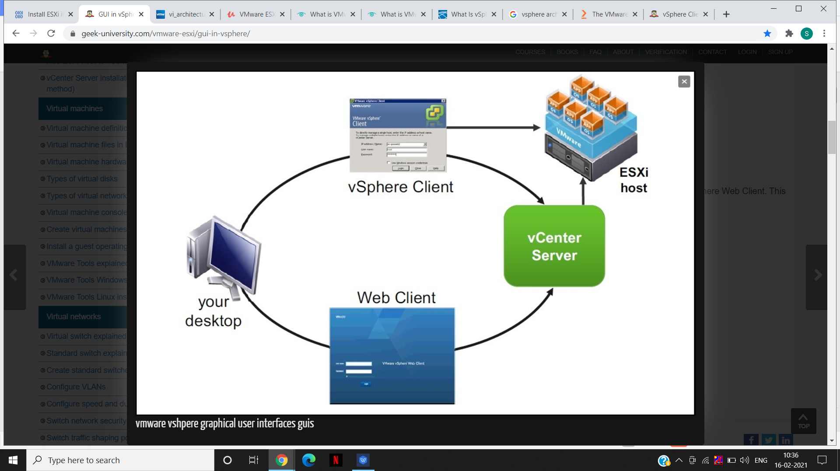
What is VMware vSphere Client
vSphere Client – this Windows-only application used to be the primary administrative interface in vSphere. The vSphere Client can be used to connect to a VMware vCenter Server instance or directly to an ESXi host. It offers a rich graphical user interface for all management tasks and for the advanced configuration of your vSphere environment.
vSphere Client is an interface (GUI) used to connect remotely to an ESXi host from window PC
This Client can be used to access and manage virtual Machines on the ESXi Host and also perform other Management and Configuration Task.

Slide 10
Firstly, you should understand the VMware vSphere architecture before considering how to optimize the performance of VMware vSphere ESXi. VMware vSphere ESXi (a hypervisor) installs the virtualization layer on an x86-based platform.
vSphere ESXi is a platform for running some virtual machines on a single physical machine.
Each VM runs on the VMM(hypervisor), which can provide virtual hardware for the guest operating system in the VM.
VMware vSphere ESXi uses the VMM to share the physical hardware (for example, CPU, memory, network, storage devices, and so on) with each virtual machine

Slide 11
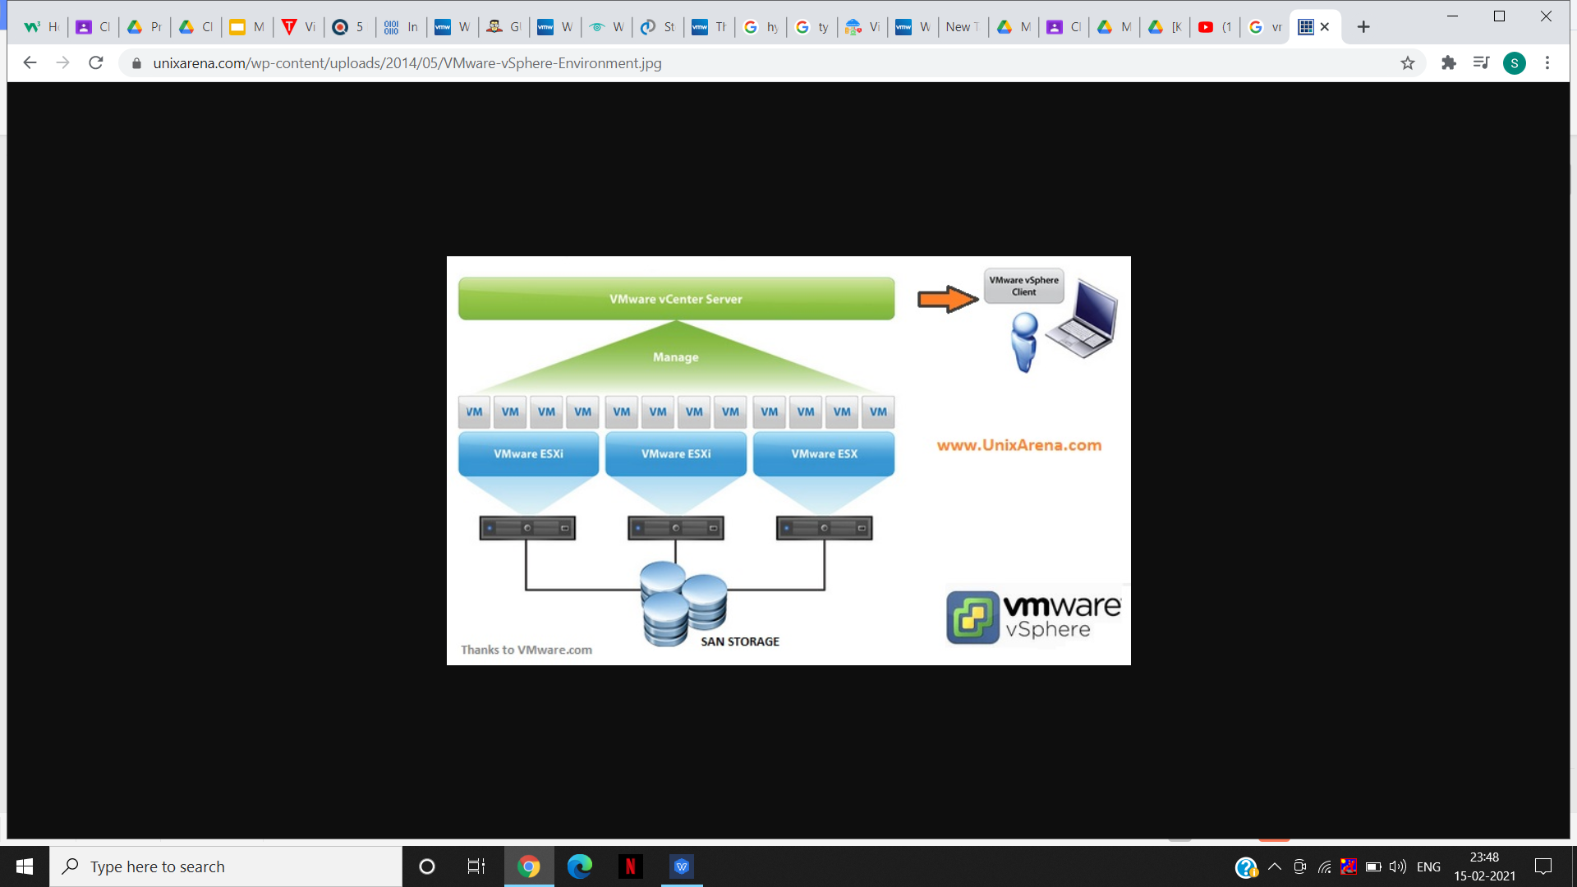
Architecture of vmware Vsphere

Slide 12
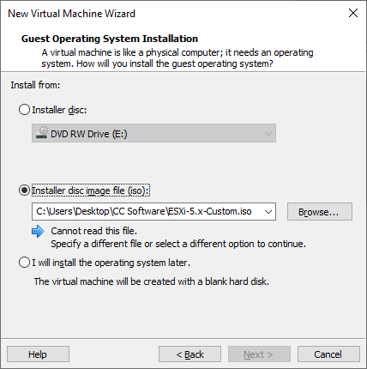
How to install vSphere Client
When IT administrators install VMware ESXi, the server is automatically assigned an IP address by the Dynamic Host Configuration Protocol server.
A message on the server console states that admins can manage the server by opening a web browser on a client computer and navigating to the host’s IP address.
Select the ESXi installer ISO in the wizard. This will detect ESXi and will configure some default settings for you, such as using 2 processors and 4 GB of RAM.

Slide 13
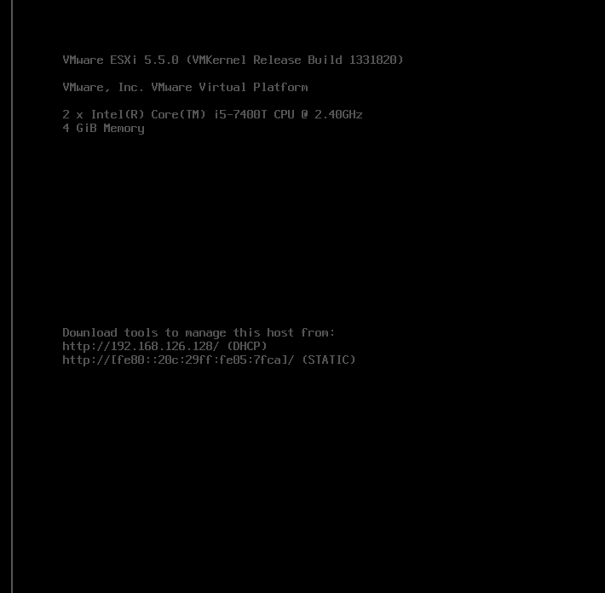
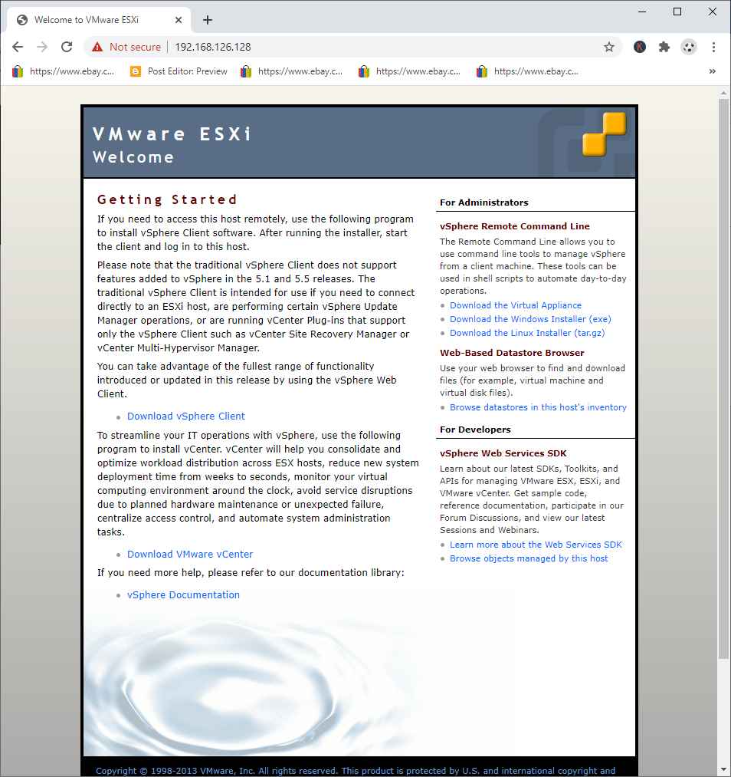
Once it is booted you can look at the server's console what IP address has been assigned to it
and you can then access the host from a browser. In the image below you see there is a download
link to download the vSphere Client. With that client you can create virtual machines and build your
vSphere environment.

Slide 14
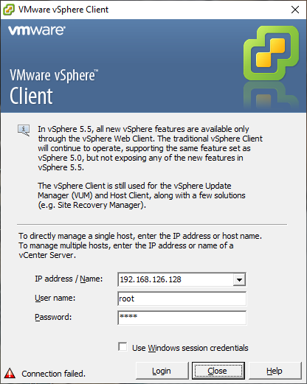
Log in to the system using the root account and password you set up during the ESXi installation.

Slide 15
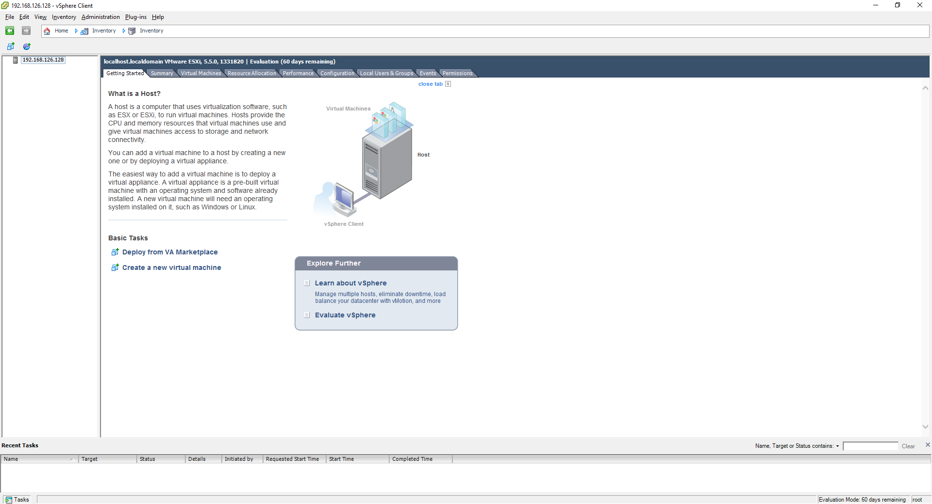
Now you can use vSphere Client to manage your ESXi host.The vSphere Client can be used to create VMs.

Slide 16
vSphere features.
1. vMotion
• Move a VM without interruption from one host to another
2. Storage vMotion
• Move VM’s files (disks) without interruption from one datastore to another
3. Distributed Resource Scheduler
• Uses (s) vMotion to migrate VMs between hosts and datastores for resource balancing
4. High Availability
• In case of host failure will restart the VMs on a different host, short downtime
5. Fault Tolerance
• Runs a perfect copy of a VM and switches over to it in case of hardware failure

Slide 17
Thank You

